Slide 1
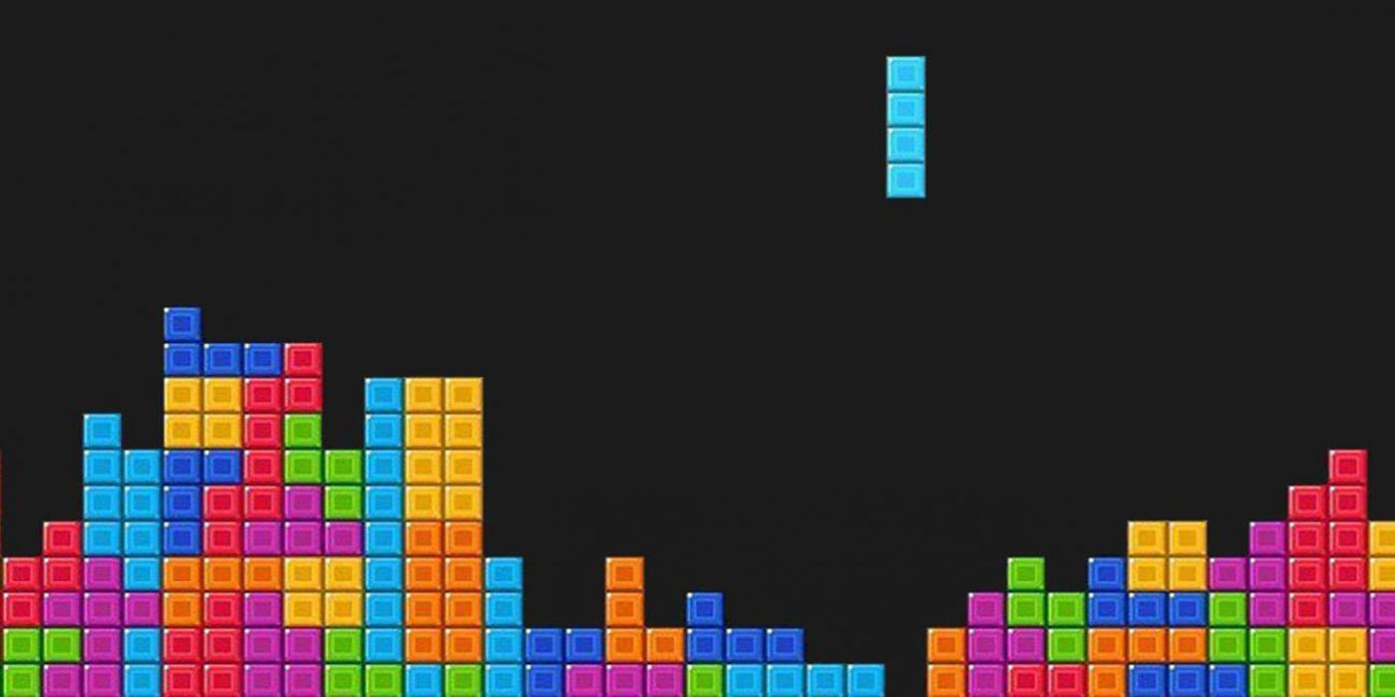

Tetris Game Player
Group-23
CHO, Hangsun (20473370)
LEE, Hyunji (20670332)

Slide 2
Included features
- Tetris game is displayed on the LCD screen of STM32
- Players can view the leaderboard
- Includes Tetris BGM and other sound effects
- Players can move the block by tilting the game controller
Introduction
Implementation
Demo Video
Difficulties & Evaluation

Slide 3
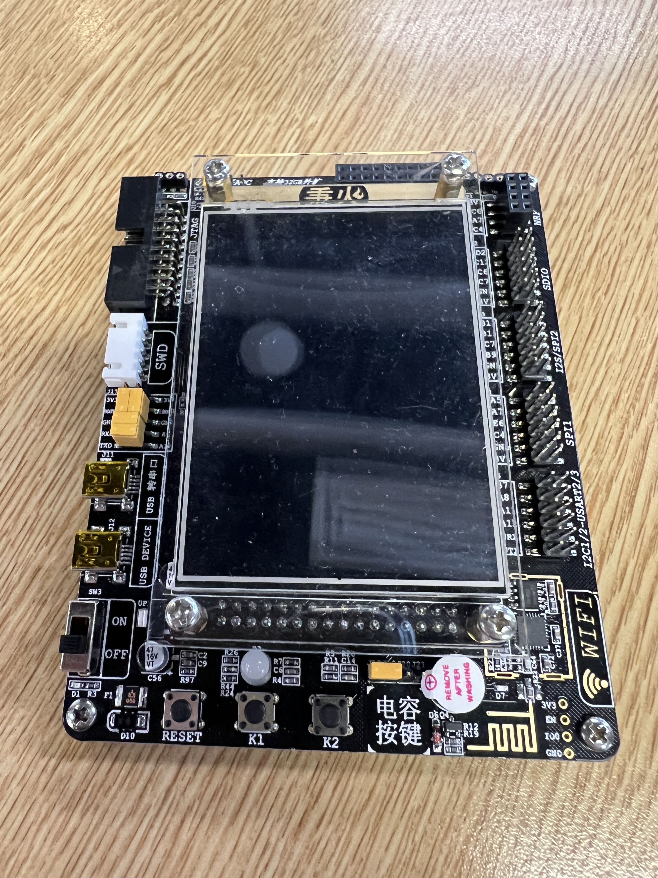
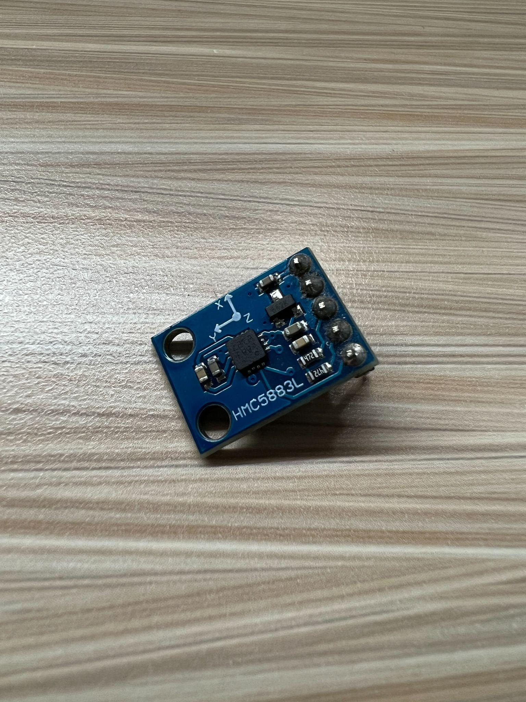
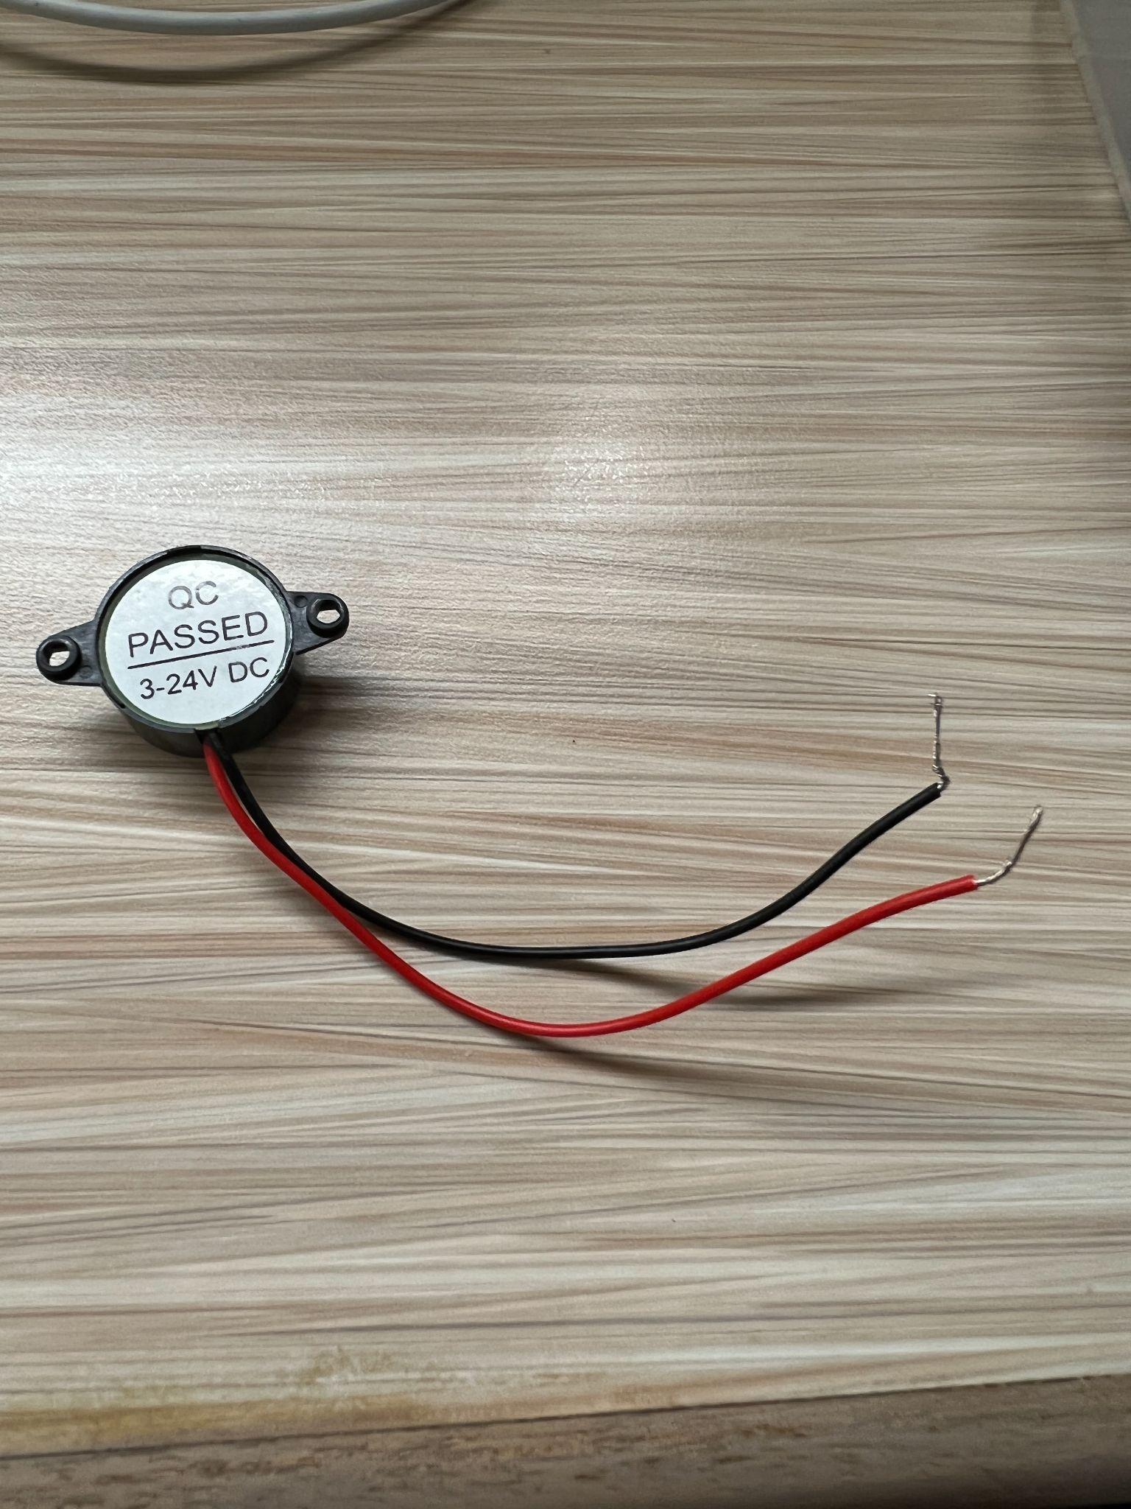
Key Hardware Components Used
- STM32F103VE LQFTP100 Board
- HMC5883L IC Module (Digital Compass)
- Piezo Buzzer
- P10 LED Board (Failed)
Introduction
Implementation
Demo Video
Difficulties & Evaluation

Slide 4
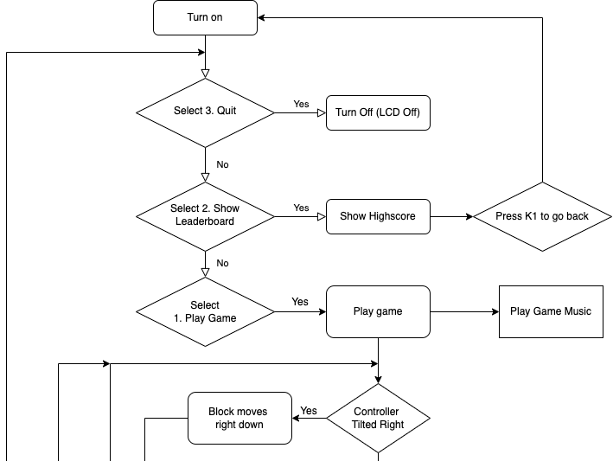
Flow Chart (1)
Introduction
Implementation
Demo Video
Difficulties & Evaluation

Slide 5
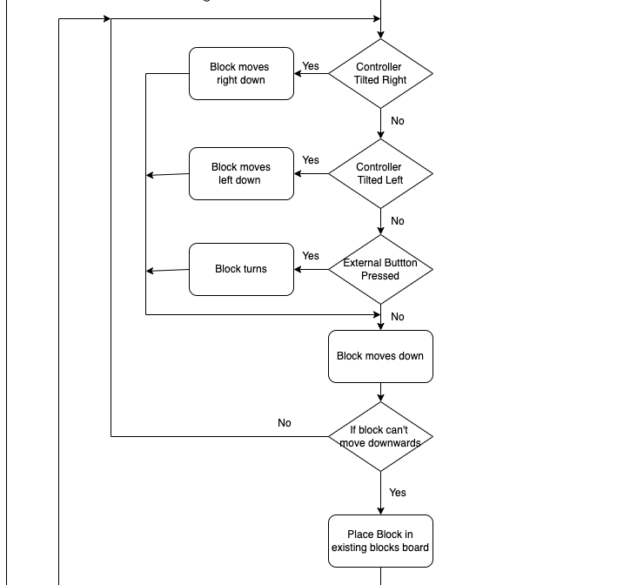
Flow Chart (2)
Introduction
Implementation
Demo Video
Difficulties & Evaluation

Slide 6
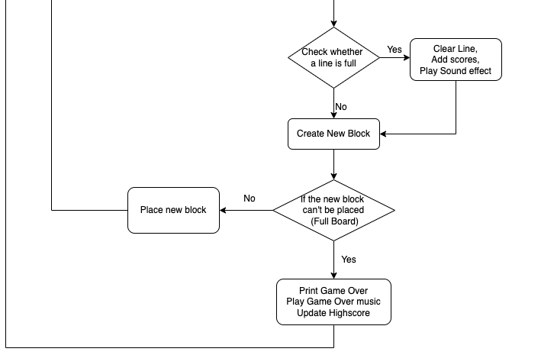
Flow Chart (3)
Introduction
Implementation
Demo Video
Difficulties & Evaluation

Slide 7
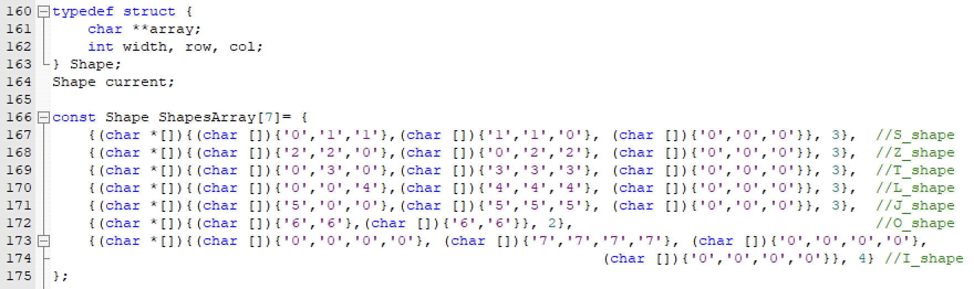
Implementation - Tetris Code Logic (1)
Introduction
Implementation
Demo Video
Difficulties & Evaluation

Slide 8
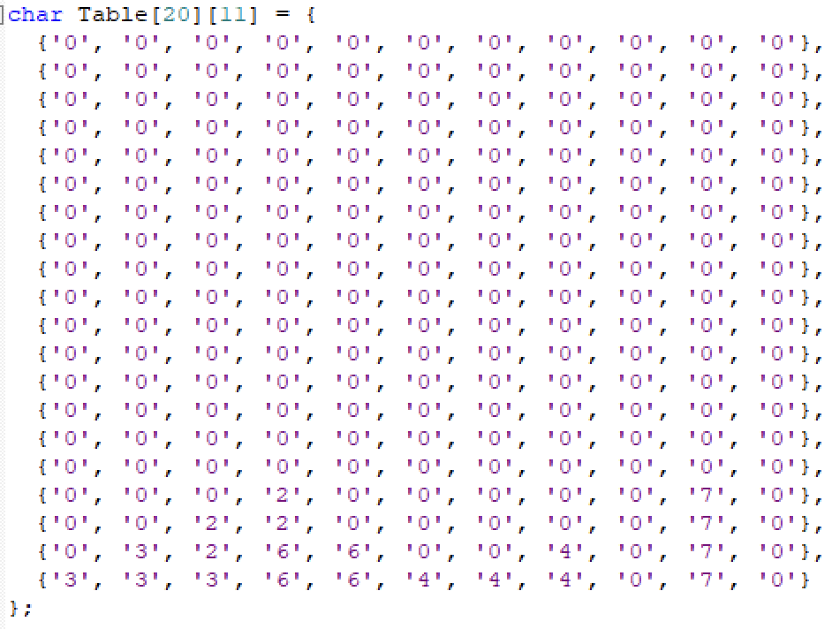
Implementation - Tetris Code Logic (2)
Introduction
Implementation
Demo Video
Difficulties & Evaluation

Slide 9
Implementation - Tetris Code Logic (3)
Introduction
Implementation
Demo Video
Difficulties & Evaluation

Slide 10
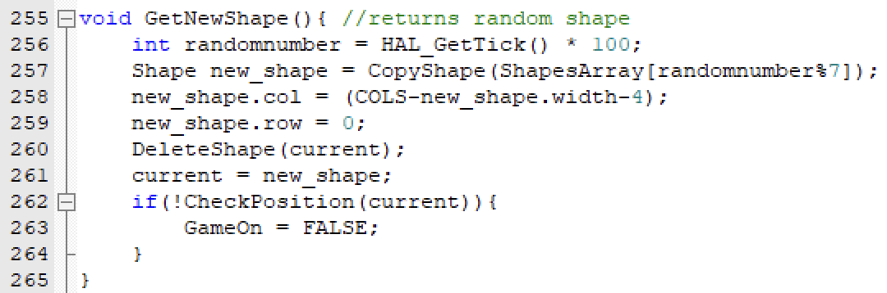
Implementation - Tetris Code Logic (4)
If current block can’t be placed,
game over!!
Introduction
Implementation
Demo Video
Difficulties & Evaluation

Slide 11
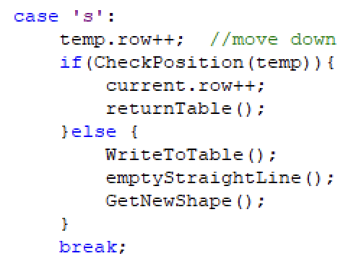
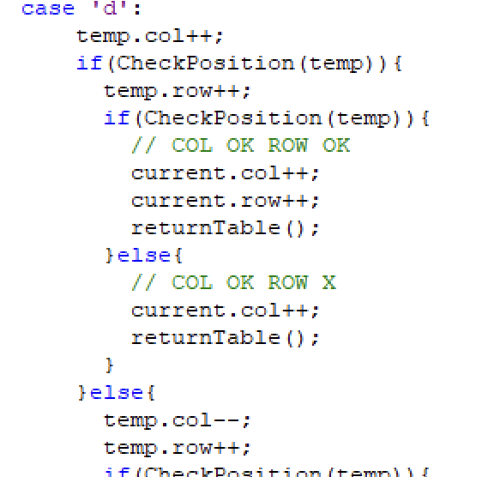
Implementation - Tetris Code Logic (5)
Move Down
Move Right
Introduction
Implementation
Demo Video
Difficulties & Evaluation

Slide 12
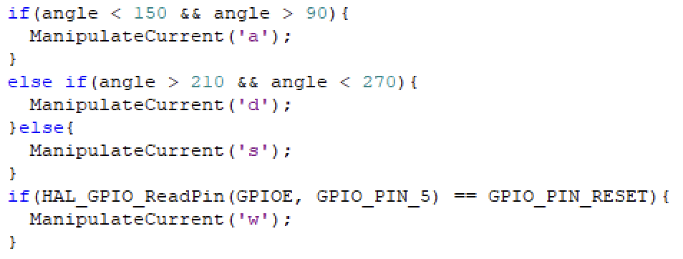
Implementation - Tetris Code Logic (6)
In main while(1) loop,
while(1) {
………
………
}
Introduction
Implementation
Demo Video
Difficulties & Evaluation

Slide 13
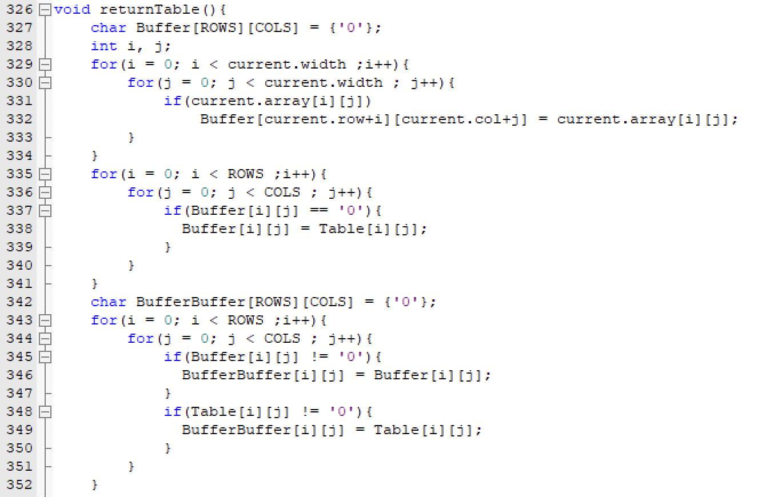
Implementation - Tetris Code Logic (7)
Then, print the array in LCD screen using the function
LCD_DrawArray(55, 10, BufferBuffer, 12);
Introduction
Implementation
Demo Video
Difficulties & Evaluation

Slide 14
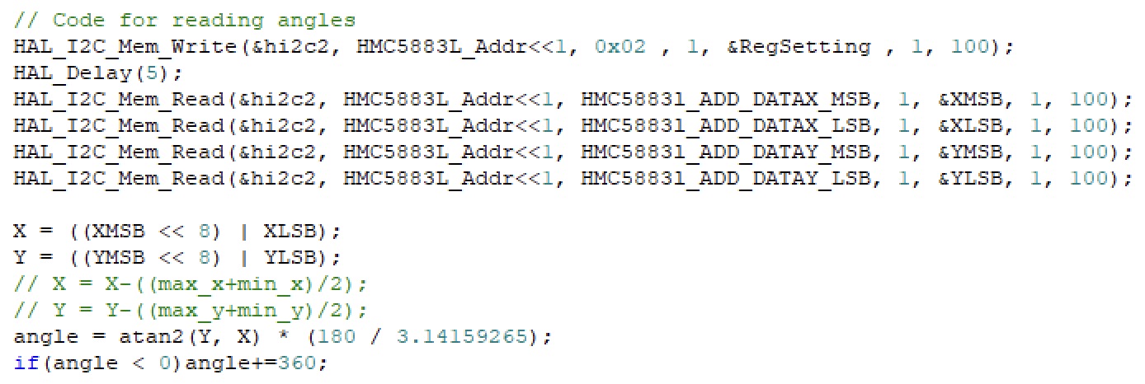
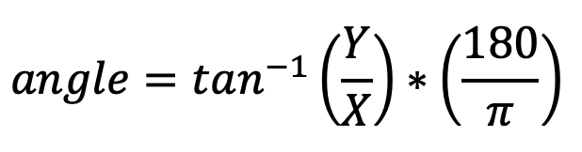
Implementation - Digital Compass (1)
Similar to LAB6, angle is read using the HMC5883L IC Module
Introduction
Implementation
Demo Video
Difficulties & Evaluation

Slide 15
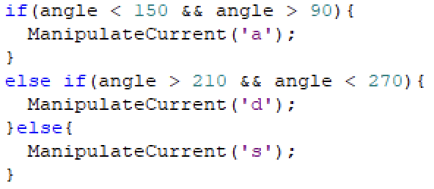
Implementation - Digital Compass (2)
180º
150º
210º
‘s’
= down
‘a’
= left
‘d’
= right
90º
270º
Introduction
Implementation
Demo Video
Difficulties & Evaluation

Slide 16
Implementation - Timer Interrupt (1)
Trigger interrupt on each red circle
……
int song_index = 0;
enum notes A[] = {G4, D4, E4, F4, E4, D4, C4, C4, …}
Buzzer is kept on. (unless other special cases)
In each interrupt,
- stop the buzzer (PWM)
- increment song_index
- change the frequency of PWM using A[song_index]
- start the buzzer (PWM)
Introduction
Implementation
Demo Video
Difficulties & Evaluation

Slide 17
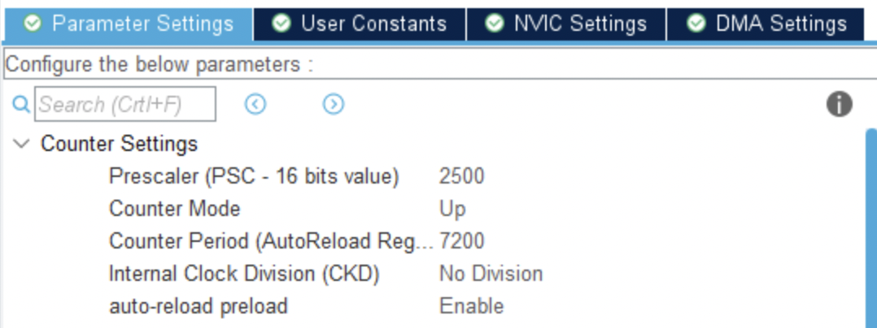
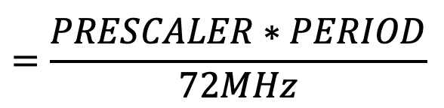
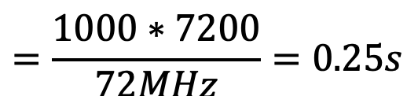
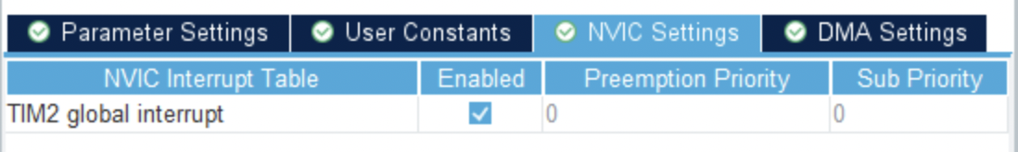
Implementation - Timer Interrupt (2)
Introduction
Implementation
Demo Video
Difficulties & Evaluation

Slide 18
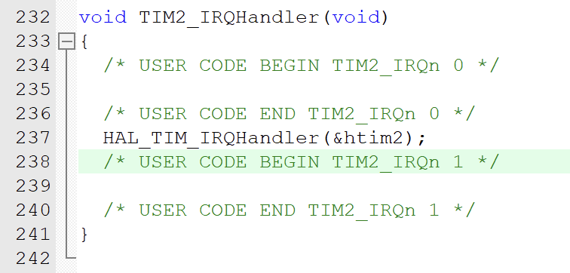
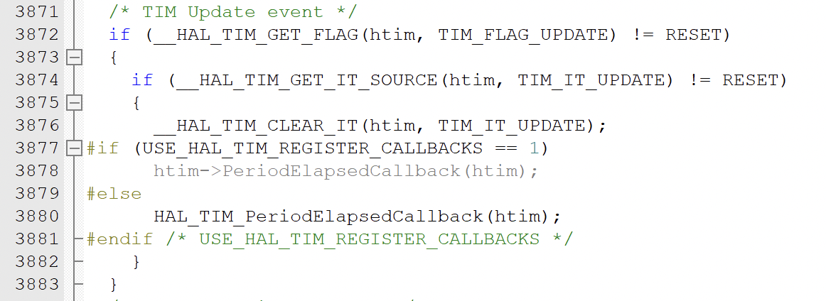
Implementation - Timer Interrupt (3)
Interrupt handling in
“stm32f1xx_it.c”
Function
HAL_TIM_IRQHandler(TIM_HandleTypeDef *htim)
defined in “stm32f1xx_hal_tim.c”
It calls HAL_TIM_PeriodElapsedCallback(htim) function when interrupt is triggered.
Introduction
Implementation
Demo Video
Difficulties & Evaluation

Slide 19
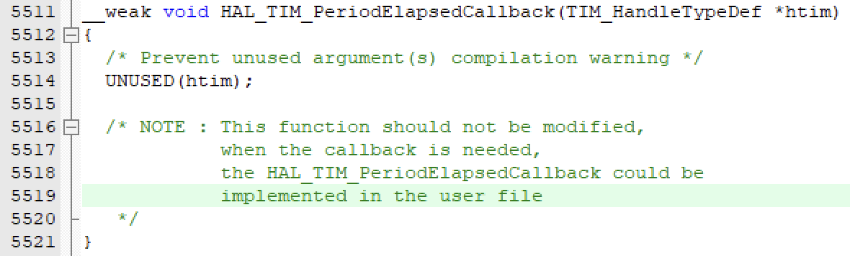
Implementation - Timer Interrupt (4)
Weak function definition of HAL_TIM_IRQHandler in “stm32f1xx_it.c”
Introduction
Implementation
Demo Video
Difficulties & Evaluation

Slide 20
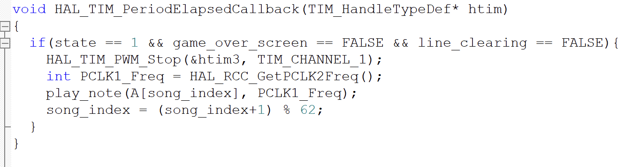
Implementation - Timer Interrupt (5)
In each interrupt trigger,
1. Stop the PWM in htim3
2. Change frequency (music note)
3. Start the PWM in htim3 with the changed frequency
4. Increment song index by one.
Our own definition of function
HAL_TIM_IRQHandler(TIM_HandleTypeDef *htim)
in “main.c”
Introduction
Implementation
Demo Video
Difficulties & Evaluation

Slide 21
Implementation - Timer Interrupt (6)
Main Game Flow
Play Game Music
while(1){
… start game
…
… read tiltation
… move block down
…
…
… create new block
…
}
HAL_TIM_Base_Start(&htim3);
…
…
if interrupt
(triggered in specific time intervals),
stop PWM
change frequency
restart PWM
increment index of notes
…
…
These two run in parallel, without interfering each other!
Introduction
Implementation
Demo Video
Difficulties & Evaluation

Slide 22
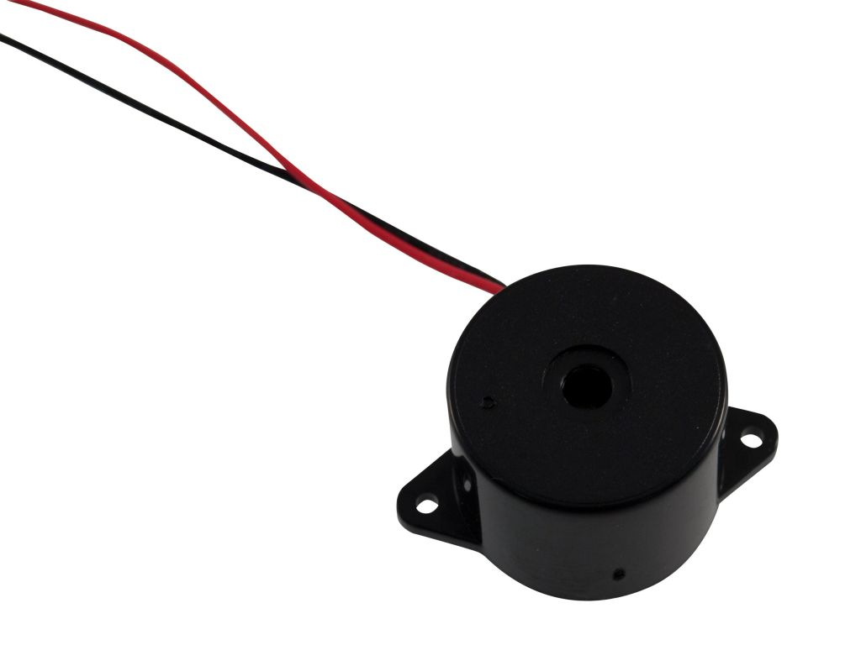
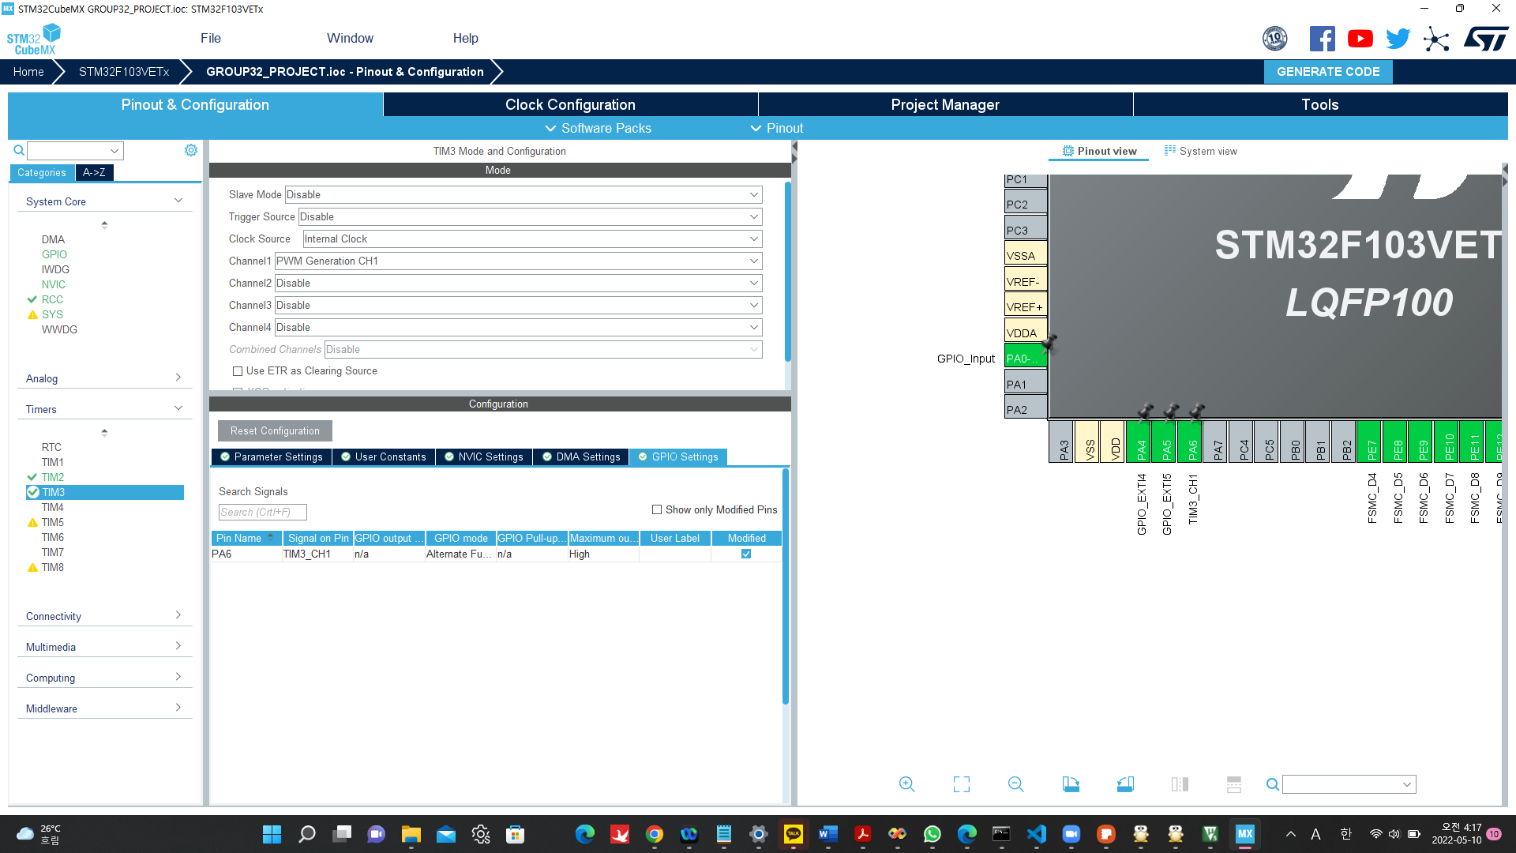
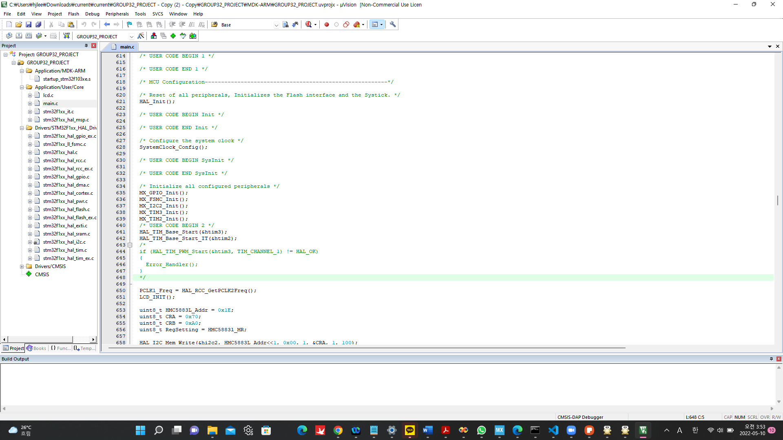
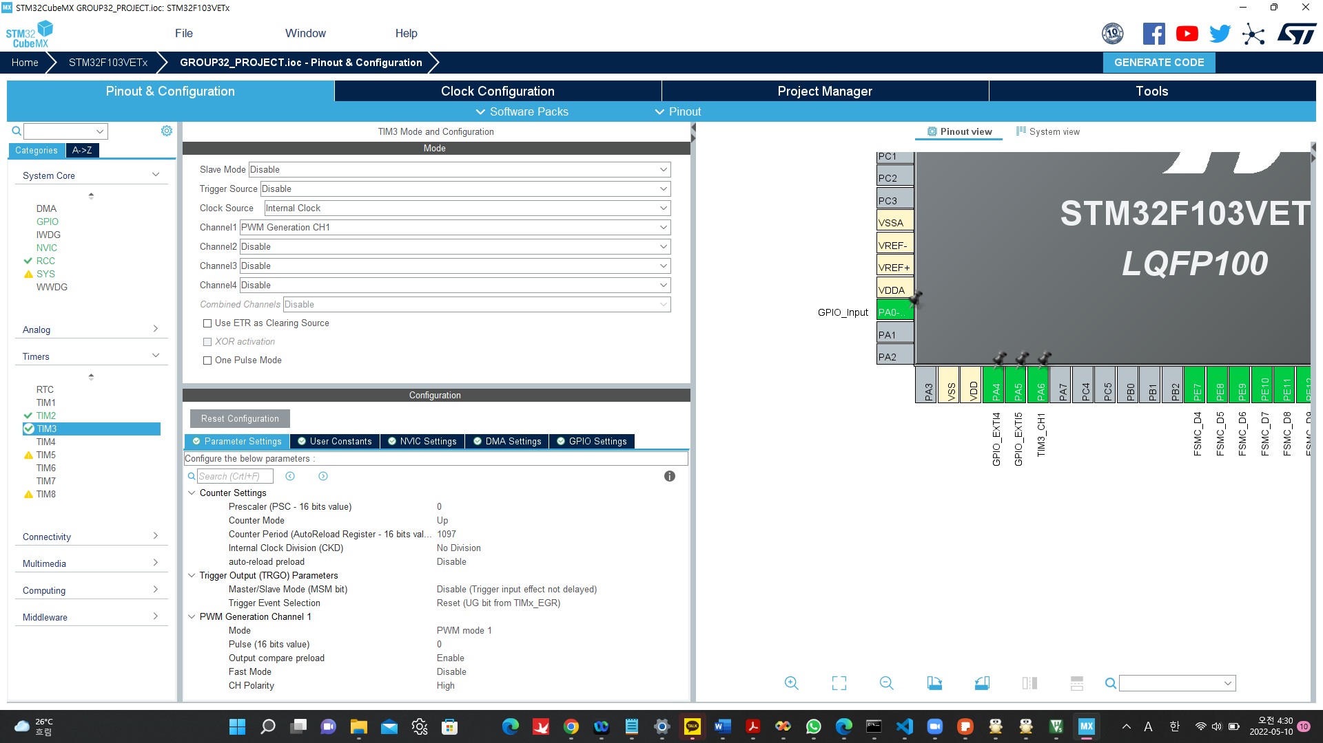
Implementation - Play music using buzzer (1)
Set the PA6 to TIM3_CH1 to use the PWM
Use a Piezo Buzzer and PWM to control the sound
HAL_TIM_Base_Start function start the Timer3
Get Clock Speed from TIM3
Introduction
Implementation
Demo Video
Difficulties & Evaluation

Slide 23
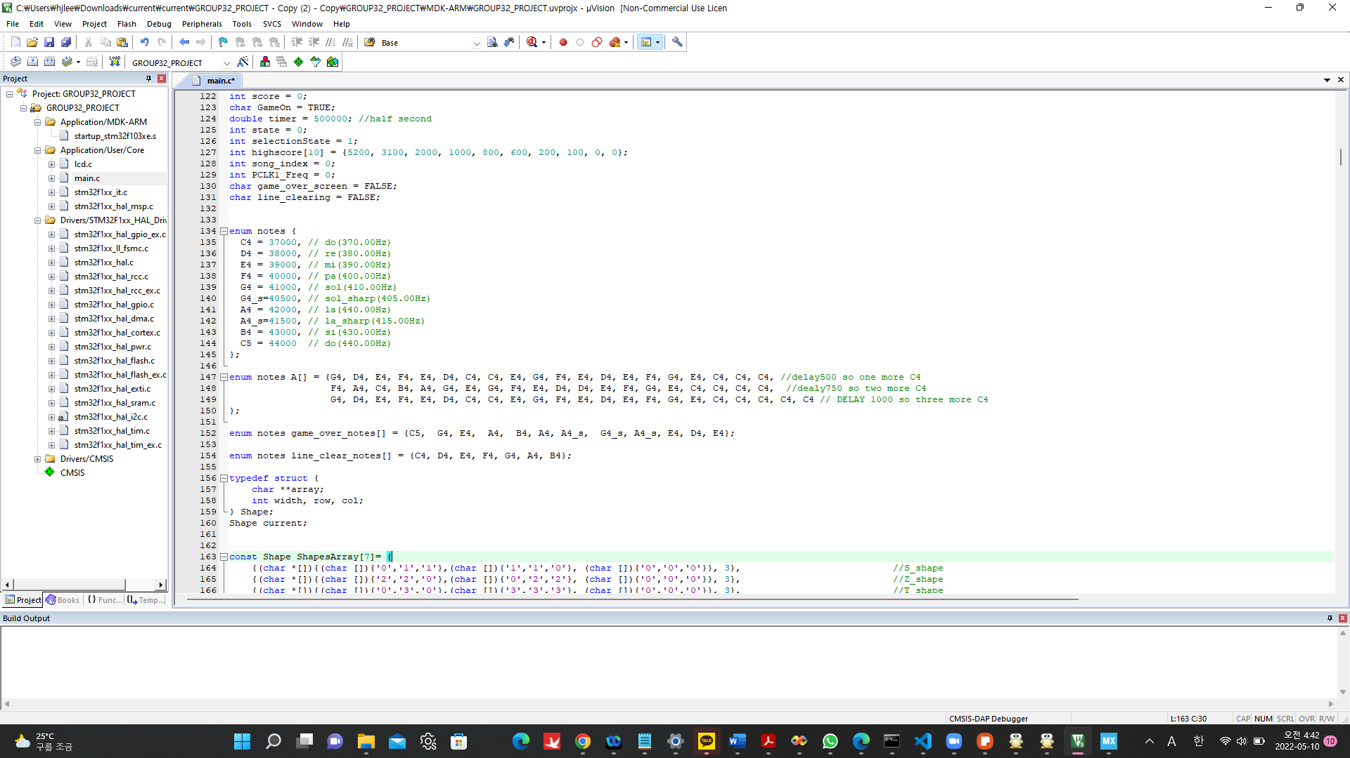
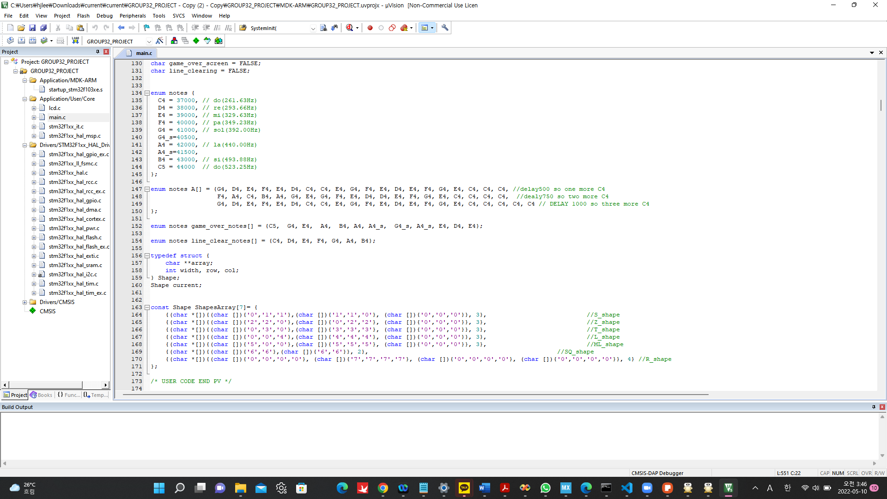
Implementation - Play music using buzzer (2)
Find frequencies corresponding with notes
*Different to original frequencies of notes
enum notes A: main Tetris music
Introduction
Implementation
Demo Video
Difficulties & Evaluation

Slide 24
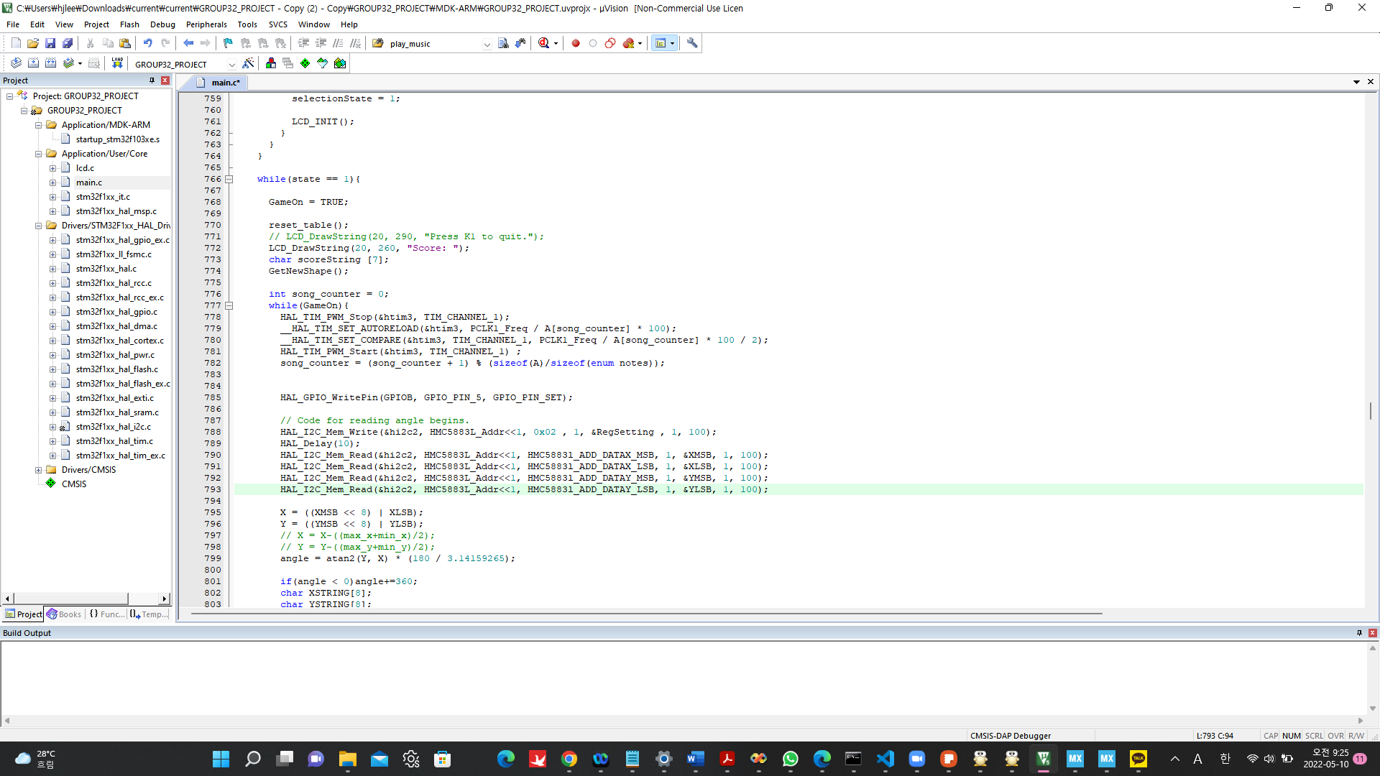
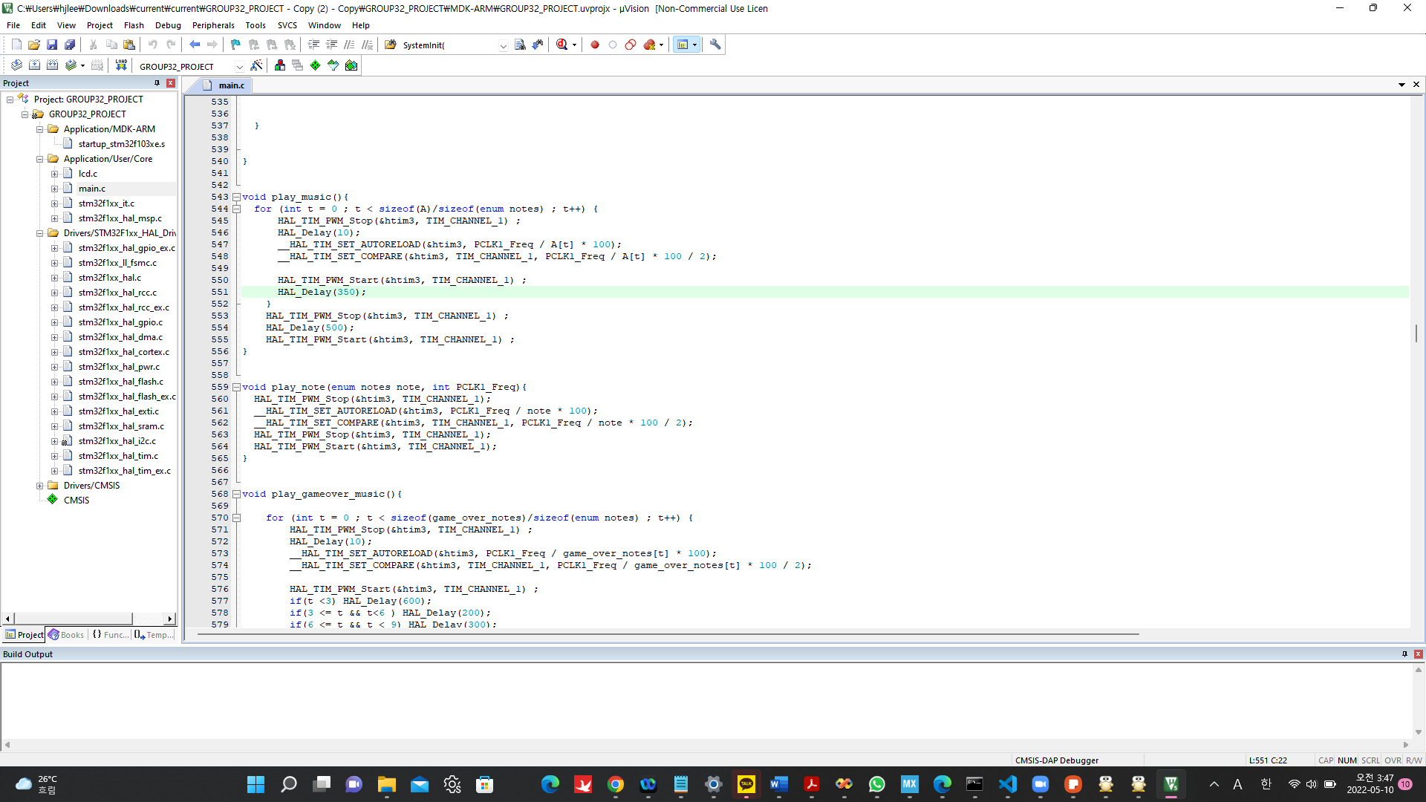
Implementation - Play music using buzzer (3)
change the song_counter-turn of the A note to htim3
play_note function is used for Timer interrupt
Restart the PWM and play new sound(note) with different frequency
Introduction
Implementation
Demo Video
Difficulties & Evaluation
Notes:
autoreload와 compare함수 계산 방법도 쓸까요?

Slide 25
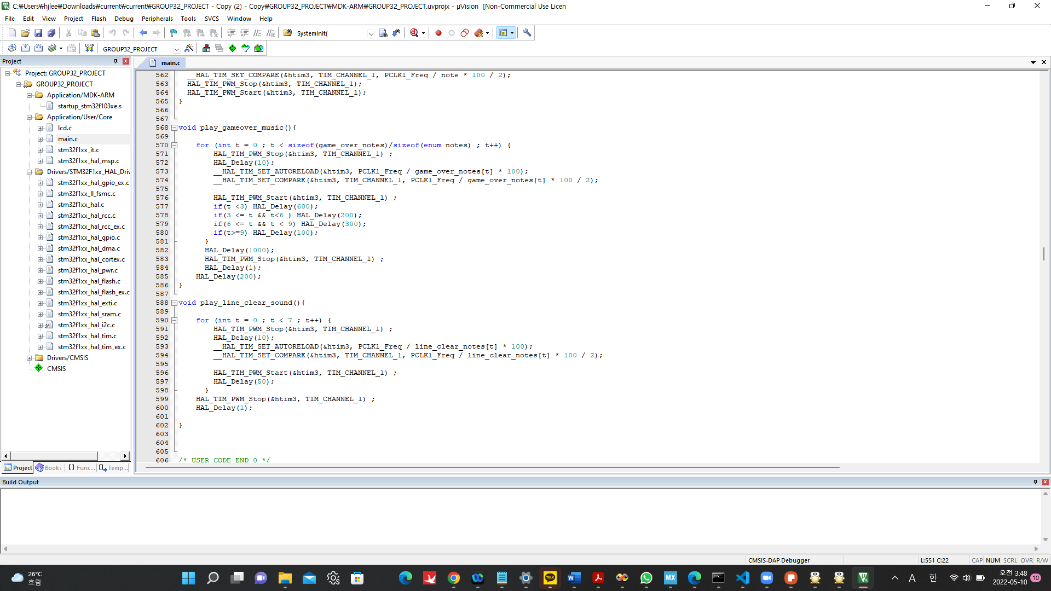
Implementation - Play music using buzzer (4)
One cycle of
line_clear_notes
To control beat, give different delays
Introduction
Implementation
Demo Video
Difficulties & Evaluation

Slide 26
Difficulties and Evaluation (1)
Difficulties
Failed to connect the LED dot matrix (P10 board) with STM32
Printed Tetris on STM32 LCD instead
Had difficulties in determining the frequency of each note
Not same as original frequencies of notes
Found approximate frequencies after trial and error
Play music and control game simultaneously
Used timer interrupt
Introduction
Implementation
Demo Video
Difficulties & Evaluation

